Slide 1
Chapter Six
Client-Side Scripting Language - JavaScript

Slide 2
Objectives
Explain the concept of client-side scripting and its role in web development
Use JavaScript variables, operators, and control structures to create dynamic web content.
Handle user interactions and events using JavaScript event listeners.
Implement form validation for user input handling.
Create dynamic content using JavaScript to manipulate DOM elements
Apply filters and transitions to web page elements to enhance visual effects and interactivity.

Slide 3
Introduction
JavaScript is a client-side scripting language
scripting language: is to mean that statements are interpreted one by one at runtime unlike programming languages that are compiled first before running
Client-side: is to mean that it is run on the client’s browser
JavaScript is run on an internet browser, like Chrome or Firefox. Every browser has an exclusive JavaScript engine to execute code.
Nowadays, JavaScript can execute not only in the browser, but also on the server, or on any device that has the JavaScript engine.
JavaScript borrows most of its syntax from Java, C, and C++

Slide 4
Cont’d
JavaScript code can be placed in the <body>, or in the <head> section of an HTML page, inserted between <script> and </script> tags. Example
<script>
var x = 5;
</script>
JavaScript can be also placed externally and imported to a page.
<html>
<head>
<script src="abc.js"></script>
</head>
<body>
</body>
</html>

Slide 5
A single <script> tag can’t have both the src attribute and code inside.
This won’t work:
<script src="file.js">
alert(1); // the content is ignored, because src is set
</script>

Slide 6
Takeaway questions
Where can you place JavaScript code within an HTML page, and what HTML tags are used for this purpose?
Declare a variable using JavaScript.
How it is inserted into an HTML document?

Slide 7
JavaScript Variables and Data Types

Slide 8
JavaScript Variables
When a program needs to hold on to a value for future use, it assigns the value to (or “stores” the value in) a variable.
A variable defines a symbolic name for a value and allows the value to be referred to by name.
In JavaScript, when declaring a variable, dynamic typing is used,
Dynamic typing allows variables to accommodate values of any data type without the need for explicit definition of a data type.
Notes:
In statically typed languages, you must declare the type of a variable when you create it, and that type cannot change.
In dynamically typed languages, you don’t have to specify the type of a variable when you declare it. The type is determined at runtime, based on the value assigned to the variable.

Slide 9
Variable Declarations
JavaScript has three kinds of variable declarations.
var
Declares a variable, optionally initializing it to a value.
var amount = 99.99;
let
Declares a block-scoped, local variable, optionally initializing it to a value.
let y = 6;
const
Declares a block-scoped, read-only named constant.
const TAX_RATE = 0.08;

Slide 10
Variable Declarations
A variable should be declared only once.
A repeated declaration of the same variable is an error:
let message = "This";
let message = "That"; // Syntax Error: 'message' has already been declared

Slide 11
Values & Types
JavaScript has typed values, not typed variables. I.e., Only values have types in JavaScript
Example,
var att;
typeof att; // "undefined"
att = "hello world";
typeof att; // "string“
Typeof is an operator used for type checking and returns the data type of the operand passed to it
Notes:
variables are just simple containers for those values

Slide 12
JavaScript types
JavaScript defines eight built-in types:
number
bigint
String
null
undefined
boolean
object
symbol -- added in ES6!
Note: All of these types except object are called "primitives".

Slide 13
Number
The number type represents both integer and floating point numbers.
Besides regular numbers, there are so-called “special numeric values” which also belong to this data type:
Infinity: represents the mathematical Infinity ∞. It is a special value that’s greater than any number.
console.log( 1 / 0 ); // Infinity
console.log(Infinity); //Infinity
NaN : represents a computational error. It is a result of an incorrect or an undefined mathematical operation
console.log("not a number" / 2 ); // NaN, such division is erroneous
console.log( 3 * NaN ); // any further mathematical operation on NaN returns NaN
Notes:
NaN stands for “not a number”, even though it is a value of the number type
Special numeric values formally belong to the “number” type.

Slide 14
BigInt
The “number” type cannot safely represent integer values larger than 2⁵³-1 (that’s 9,007,199,254,740,991), or less than -(2⁵³-1) for negatives.
Outside of the safe integer range there’ll be a precision error. For example, the following two numbers are the same:
console.log(9007199254740991 + 1); // 9007199254740992
console.log(9007199254740991 + 2); // 9007199254740992
BigInt type can represent integers of very long length.
A BigInt value is created by appending n to the end of an integer:
const bigInt = 1234567890123456789012345678901234567890n;

Slide 15
String
A JavaScript string is zero or more characters written inside quotes.
In JavaScript, there are 3 types of quotes.
Double quotes: let str="Hello“;
Single quotes: let str2 = 'Hello‘;
Backticks: let str3=`Hello`;
Double and single quotes are “simple” quotes. They are almost the same
Backticks allow us to embed variables and expressions into a string by wrapping them in ${…}, for example
console.log( `Hello, ${name}!` ); //name is a variable
Notes:
Backticks also support multiline strings

Slide 16
The “null” value
For the null type, there is one and only one value: null . So the label is both its type and its value.
let age = null;
In JavaScript, null is not a “reference to a non-existing object” or a “null pointer” like in some other languages.
It’s just a special value which represents “nothing”, “empty” or “value unknown”.
The code above states that age is unknown.
The typeof operator for “null”, returns "object" – this is an error in the language, it’s not actually an object.

Slide 17
The “undefined” value
The special value undefined also a type of its own, just like null.
The meaning of undefined is “value is not assigned”.
If a variable is declared, but not assigned, then its value is undefined:
let age;
console.log(age); // shows "undefined“
Both undefined and null are often taken to be interchangeable as either "empty" values or "non" values. But they can also be distinguished as,
null is an empty value
undefined is a missing value

Slide 18
The “undefined” value
A return statement with no value (return;) implicitly returns undefined.
Accessing a nonexistent object property (obj.iDontExist) returns undefined.
A variable declaration without initialization (let x;) implicitly initializes the variable to undefined.

Slide 19
Takeaway questions
What is dynamic typing, and how does it differ from static typing in other programming languages?
What are the three types of variable declarations in JavaScript, and how do they differ in terms of scope and initialization?
What would be returned after the following operation?
var x;
x=22.3;
typeof x;
Declare a String, number, boolean, null and undefined variable

Slide 20
The Object Data type
There are eight data types in JavaScript.
Seven of them are called “primitive”, because their values can contain only a single value
In contrast, objects are used to store collections of data and more complex entities.
The object type refers to a compound value where you can set properties that each hold their own values of any type.
An empty object (“empty cabinet”) can be created using one of two syntaxes:
let user = new Object(); // "object constructor" syntax
let user = {}; // "object literal" syntax

Slide 21
The Object Data type
A property has a key (also known as “name” or “identifier”) before the colon ":" and a value to the right of it.
var obj = {
a: "hello world",
b: 42,
c: true };
Properties can either be accessed with dot notation (i.e., obj.a) or bracket notation (i.e., obj["a"]).
obj.a; // "hello world"
obj.b; // 42
obj.c; // true
Notes:
Dot notation is shorter and generally easier to read, and is thus preferred when possible

Slide 22
Takeaway questions
Create an object named book with properties for title, author, and pages.
Add a new property genre to the book object and set its value to "Fiction".
Access the author property of the book object using both dot notation and bracket notation.
Update the pages property of the book object to 500.
Remove the genre property from the book object.
Notes:
delete book.genre;

Slide 23

Symbol
A Symbol is a unique and immutable primitive value and may be used as the key of an Object property.
The purpose of symbols is to create unique property keys that are guaranteed not to clash with keys from other code.
To create a new primitive Symbol, you write Symbol() with an optional string as its description
Notes:
a symbol primitive — also called a Symbol value or just a Symbol — that's guaranteed to be unique.

Slide 24

Symbol
When you call Symbol(), it returns a symbol primitive,
A primitive is a basic value (like a number, string, or boolean).
Symbols are neither objects nor strings but have their own type: "symbol".
Every Symbol() call is guaranteed to return a unique Symbol.
Every Symbol.for("key") call on the other hand will always return the same Symbol for a given value of "key".
In contrast, Symbol.for("key") ensures that symbols with the same key are shared
Notes:
When you call Symbol.for("key"), it checks the global Symbol registry to see if a symbol with the specified "key" doesn’t exist, a new symbol is created

Slide 25
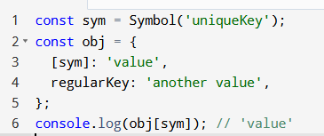
Why Use Symbols?
Uniqueness: Symbols are commonly used as property keys in objects to avoid property name collisions.
For example:
Notes:
Object.getOwnPropertyNames(book);

Slide 26

Takeaway questions
How do Symbol() and Symbol.for() differ in their behavior?
Create a Symbol and assign it to a variable called symID
Add a property with a Symbol key to the object, “book”. The symbol should represent an ID.
Access the property with a Symbol key in the following object
Notes:
Symbols cannot be accessed using dot notation

Slide 27
Truthy and Falsy
In JavaScript, values are inherently considered either truthy or falsy when evaluated in a boolean context (such as in an if statement).
if ("hello") {
console.log("This is truthy.");}
if (0) {
console.log("This is falsy.");}
Any value in JavaScript that is considered true when encountered in a boolean context is termed truthy.
Examples of truthy values include: Non-empty strings ("hello"), Non-zero numbers (42, -3.14), Arrays and objects (even if they are empty), Functions, true

Slide 28
Truthy and Falsy
Falsy Values:
Conversely, values that are considered false in a boolean context are termed falsy. Examples of falsy values include:
An empty string ("")
0
NaN (Not-a-Number)
null
undefined
false

Slide 29
“False vs. Falsy” “True vs. Truthy”
True:
Refers specifically to the Boolean value true.
Example: let y = true; assigns the Boolean value true to y.
Truthy:
Refers to any value that is treated as true in a Boolean context.
False:
Refers specifically to the Boolean value false.
Example: let x = false; assigns the Boolean value false to x
Falsy:
Refers to any value that is treated as false in a Boolean context (like in an if statement or a logical operation).

Slide 30
Coercion

Slide 31
Coercion
Coercion in JavaScript refers to the automatic or implicit conversion of values from one data type to another
Coercion comes in two forms in JavaScript: explicit and implicit.
Explicit coercion is characterized by its overtness within the code, where a conversion from one data type to another is readily apparent.
var a = "42";
var b = Number( a );
Conversely, implicit coercion occurs more subtly, as a secondary consequence of another operation.
var a = "42";
var b = a * 1;
Notes:
False/True are strict Boolean values (false and true).
Falsy/Truthy are broader categories that describe how any value behaves in a Boolean context (truthy values evaluate to true, and falsy values evaluate to false).

Slide 32
Common Coercion Scenarios
If either operand is a string and the operator is +, both operands are coerces to strings for concatenation.
'5' + 3; // "53" (String coercion)
For -, *, /, operands are coerced to numbers.
'5' - 3; // 2 (Number coercion)
For <, >, <=, >=, operands are coerced to numbers unless they are strings,
'5' < 10; // true (Number coercion)
'5' < '10'; // true (String comparison)
Notes:
Lexicographical comparison is a method of comparing strings based on the alphabetical order of their characters, similar to how words are arranged in a dictionary.

Slide 33
What will be the result of the following expressions?
'10' + 5;
'5' - 3;
'5' == 5;
null == 0;
'3' > 2;
'0' == false;
Notes:
null is not coerced to a number during loose equality checks. It becomes undefined. 4 is false

Slide 34
Equality
There are four equality operators: == , === , != , and !== .
The difference between == and === is characterized as,
== checks for value equality with coercion allowed,
=== checks for value equality without allowing coercion;
=== is often called "strict equality" for this reason.
Example
var a = "42";
var b = 42;
a == b; // true coercion on the string "42" to a number before making the comparison
a === b; // false

Slide 35
Given the following variables
write the expected output for each of the following expressions when logged to the console
var x = 10;
var y = "10";
console.log(x == y);
console.log(x === y);
console.log(x != y);
console.log(x !== y);

Slide 36
Control Structures in JavaScript

Slide 37
Control Structure
By default, the JavaScript interpreter executes statements one after another in the order they are written.
JavaScript has a number of control structures to change this default order of execution
Conditionals: Statements like if and switch that execute or skip statements depending on the value of an expression
Loops: Statements like while and for that execute other statements repetitively
Jumps: Statements like break, return, and throw that cause the interpreter to jump to another part of the program

Slide 38
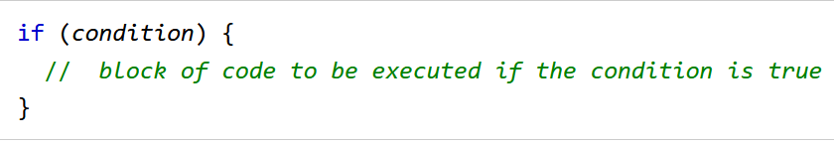
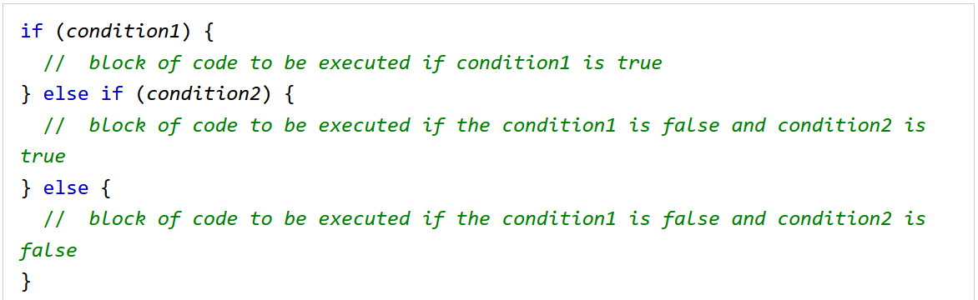
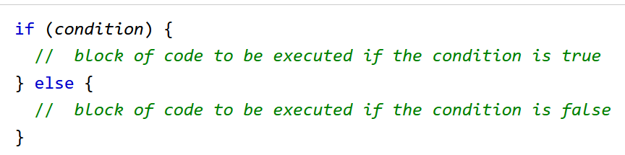
JavaScript if, else, and else if
Conditional statements are used to perform different actions based on different conditions.

Slide 39
Revision questions
Write a program that checks if a number is positive, negative, or zero. Log the result to the console.
Write a program that checks a student's grade and logs the performance level:
If the grade is 90 or above, log "Excellent".
If the grade is between 70 and 89, log "Good".
If the grade is between 50 and 69, log "Average".
Otherwise, log "Fail".

Slide 40
JavaScript For Loop
JavaScript supports different kinds of loops:
for - loops through a block of code a number of times
for/in - loops through the properties of an object
while - loops through a block of code while a specified condition is true
do/while - also loops through a block of code while a specified condition is true

Slide 41
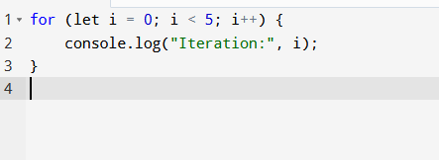
For loop
The for loop is used when the number of iterations is known. It consists of three parts: initialization, condition, and increment/decrement.
Syntax:
for (initialization; condition; increment/decrement)
{
// code block to execute
}

Slide 42
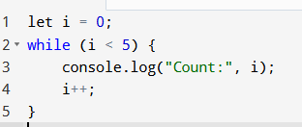
while Loop
The while loop executes as long as the specified condition evaluates to true.
Syntax:
while (condition)
{
// code block to execute
}

Slide 43
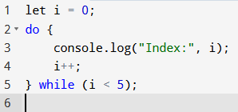
do...while Loop
The do...while loop executes the block of code once before checking the condition. It is guaranteed to execute at least once.
Syntax:
do {
// code block to execute
} while (condition);

Slide 44
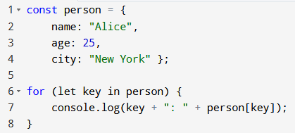
for...in Loop
The for...in loop iterates over the properties of an object or the indices of an array.
Syntax:
for (let key in object) {
// code block to execute
}
Notes:
Prints name: Alice, age: 25, city: New York

Slide 45
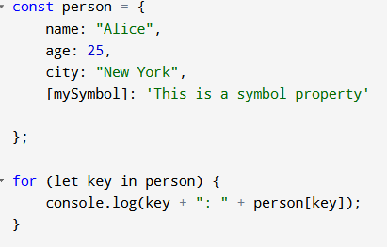
for...in Loop cont’d
Symbols are not enumerable in for...in iterations.
Each iteration returns a key (x)
The key is used to access the value of the key
Notes:
The non-enumerable behavior of symbols means that they won’t show up in methods like for...in, which are typically used to list or serialize an object’s properties.
This behavior ensures that symbol properties are effectively "hidden" from the usual ways of interacting with objects
This is intentional: symbols are often used to define properties that are meant to be "private" or "internal" to an object.

Slide 46
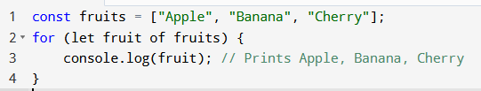
for...of Loop
The for...of loop iterates over iterable objects like arrays, strings, maps, etc.
Syntax:
for (let element of iterable) {
// code block to execute
}

Slide 47
takeaway question
Write a JavaScript program to print all even numbers between 1 and 100
Write a for loop that prints the numbers from 1 to 10, but skips 5
Write a while loop that prints numbers from 1 to 100
Write a for...in loop that prints all the properties (keys) of the following object
const car = { brand: "Toyota", model: "Corolla", year: 2020 };
Create a for...in loop that counts how many properties the following object has
const person = { name: "John", age: 30, city: "New York", country: "USA" };
6. Using a for...in loop, iterate over an object and double the value of each numeric property.
const scores = { math: 90, english: 85, science: 88 };

Slide 48
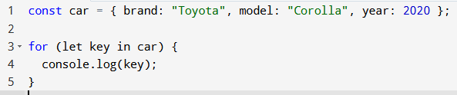
4

Slide 49
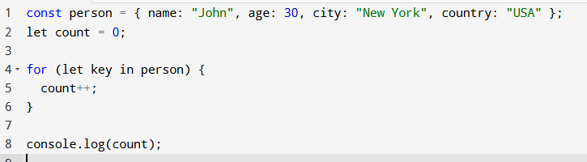
5

Slide 50
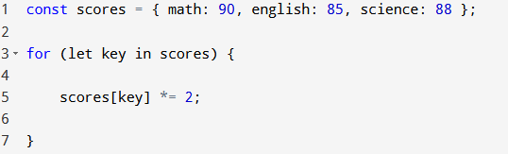
6

Slide 51
Review question
"" + 1 + 0
"" - 1 + 0
true + false
6 / "3"
"2" * "3"
4 + 5 + "px"
"$" + 4 + 5
2 + 2 + '1'
'1' + 2 + 2
"4" - 2
"4px" - 2
" -9 " + 5
" -9 " - 5

Slide 52
Functions

Slide 53
Functions
Functions are the main “building blocks” of a JavaScript program.
Functions allow a block of code to be called many times.
Syntax to create a function,
function name(parameter1, parameter2, ... parameterN) {
// body }
Example,
function myFunction(a, b) { return a * b; }
Notes:
A return keyword without an expression after it will cause the function to return undefined.
Functions that don’t have a return statement at all, similarly return undefined.

Slide 54
Takeaway questions
Write a function getMinimum(a,b) which returns the least of two numbers a and b.
Write a function pow(x,n) that returns x to the power of n. Or, in other words, multiplies x by itself n times and returns the result.

Slide 55
Function expressions
In JavaScript, a function is not merely a special language construct but rather a distinct type of value.
i.e, Functions can be
assigned to variables,
passed as arguments to other functions, and
returned as values from other functions.
Function expressions are a way of defining functions in JavaScript where the function is assigned to a variable or used directly in an expression.
Example,
let exampleFunction = function() { // Function body };
Notes:
Unlike traditional procedural programming languages where functions are primarily tools for structuring and organizing code, in JS they are distinct type of value.

Slide 56


Function expressions can be:
Anonymous
Named
Notes:
you call it using the variable name
When a function creation happens in the context of the assignment expression (to the right side of =), this is a Function Expression.

Slide 57
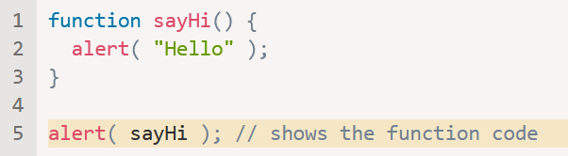
Function is a value
In JS, when a function is referenced without parentheses, it behaves like a value, and in the above code its string representation is going to be displayed
The absence of parentheses after the function name sayHi in the last line of the code prevents the function from being executed.
A function remains a special type of value, given its ability to be invoked using syntax such as sayHi(), yet it remains fundamentally a value.
Notes:
This allows functions to be manipulated similarly to other value types, enabling operations such as passing them as arguments, assigning them to variables, or returning them from other functions.

Slide 58
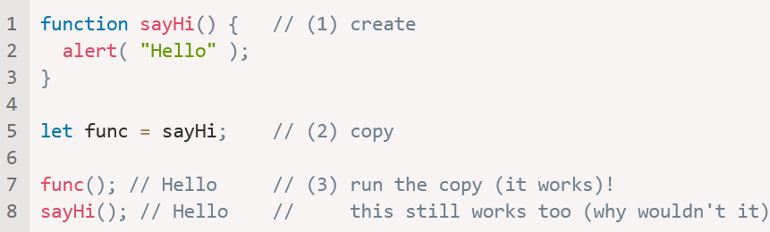
Example
Assigning functions to variables as values,
Note that if there were parenthesis after sayHi, then func = sayHi() would write the result of the call sayHi() into func, not the function sayHi itself.
Notes:
note there are no parentheses after sayHi.

Slide 59
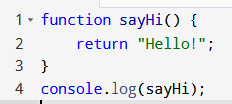
what will be logged to the console?

Slide 60
Takeaway questions
How does a function expression differ from a function declaration?
Write a function expression that adds two numbers and assigns it to a variable “add”.
Then call the method and print the result.
Create an anonymous function expression to calculate the square of a number and assign it to a variable “square”
Create a function expression that reverses a string and test it with "hello".

Slide 61

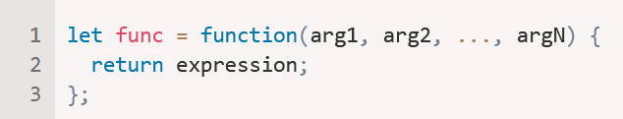
Arrow functions
Arrow functions are a more concise way to write functions in JavaScript.
They are particularly useful for creating short, anonymous functions.
Syntax,
The above code creates a function func that accepts arguments arg1..argN, then evaluates the expression on the right side with their use and returns its result.
A shorter version of:
Notes:
you call it using the variable name

Slide 62
Arrow functions
If an arrow function has only one parameter, the parentheses can be omitted.
Example:
const myFunc = x => x * 2;
console.log(myFunc(5)); // Output: 10
If there are no parameters, the parentheses must be present (though they will be empty)
Example:
const greet = ( ) => 'Hello, World!';
console.log(greet()); // Output: Hello, World!

Slide 63
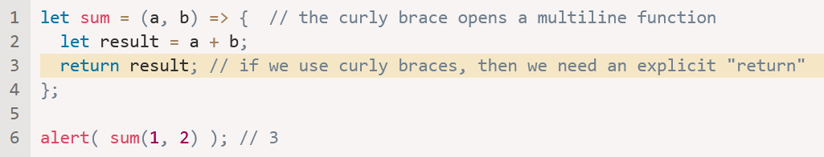
Multiline arrow functions
Sometimes we need a more complex function, with multiple expressions and statements.
In that case, we can enclose them in curly braces.
The major difference is that curly braces require a return within them to return a value (just like a regular function does).

Slide 64
Takeaway questions
How do you declare an arrow function in JavaScript? Write an example of an arrow function that multiplies two numbers.
Write an arrow function that takes two arguments, a and b, and returns their sum only if b is greater than a. Otherwise, return "Invalid".
Rewrite the following regular function as an arrow function:
function greet(name) { return `Hello, ${name}!`;}

Slide 65
Exception Handling

Slide 66
Exception Handling
Sometimes our scripts have errors.
Errors may occur because of an unexpected user input, or an erroneous server response.
Usually, a script “dies” (immediately stops) in case of an error, printing it to console.
Exception handling allows us to “catch” errors so the script instead of dying, can do something more reasonable.
There’s a syntax construct try...catch that allows us to “catch” errors

Slide 67
The try…catch syntax
try {
// code...
} catch (err) {
// error handling
}
First, the code in try {...} is executed.
If there were no errors, then catch (err) is ignored
If an error occurs, then the try execution is stopped, and control flows to the beginning of catch (err).

Slide 68
Error object
When an error occurs, JavaScript generates an object containing the details about it.
The object is then passed as an argument to catch
For all built-in errors, the error object has two main properties:
name
Error name. For instance, for an undefined variable that’s "ReferenceError".
message
Textual message about error details
try { lalala;} catch (err) {
alert(err.name); // ReferenceError
alert(err.message); // lalala is not defined

Slide 69
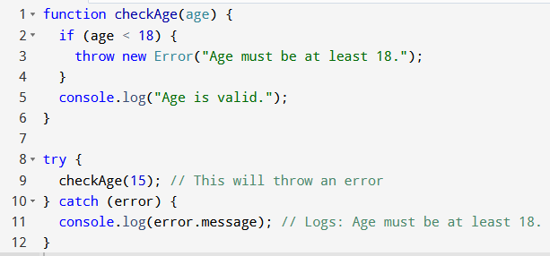
Example

Slide 70
Takeaway question
Write a function checkGrade(grade) that throws an error if the grade is less than 0. Use try...catch to call the function and log the error message if an error is thrown.
Write a function divide(a, b) that throws an error if the divisor b is zero. Use try...catch to call the function and handle the error gracefully
Notes:
function divide(a, b) { // Your code here}try { console.log(divide(10, 0)); // Should throw an error} catch (error) { console.log(error.message); // Logs the error message}

Slide 71
Revision question
Write a function expression that calculates the area of a rectangle. If only one parameter is provided, assume it's a square
console.log(calculateArea(7)); // Output: 49
Assign an anonymous function to a variable that takes a string and returns its length.
Convert this function expression into an arrow function:
const isEven = function (num) {
return num % 2 === 0;
};
Notes:
const calculateArea = function (length, width = length) {
return length * width;
};

Slide 72
Common Array Methods in JavaScript

Slide 73
Arrays
Declaring and intilizing arrays:
Literal notation: let arr = [1, 2, 3];
Constructor: let arr = new Array(3);
Accessing array elements
Example: console.log(arr[0]); // 1 !Negative indexing is not supported.
at(): Returns an indexed element
arr.at(1) // 2
Arr.at(-1); //3 Negative indices: Count backwards from the end of the array
Notes:
arr.at(-1) retrieves the last element of the array arr

Slide 74
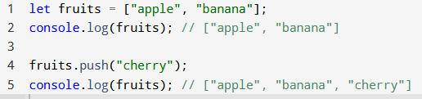
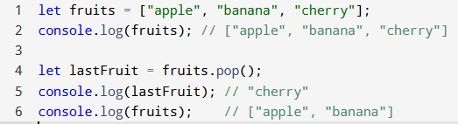
Common Array Methods
push(): adds one or more elements to the end of an array and returns the new length of the array.
pop(): removes the last element from an array and returns the removed element. If the array is empty, it returns undefined.

Slide 75
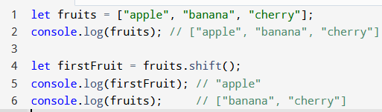
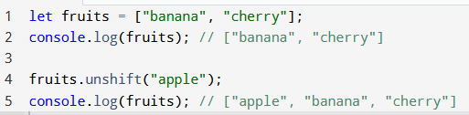
Common Array Methods
shift(): removes the first element from an array and returns the removed element. If the array is empty, it returns undefined.
unshift(): adds one or more elements to the beginning of an array and returns the new length of the array.

Slide 76
let arr=["a", "b", "c"];
arr.push("d");
arr.pop();
arr.shift();
arr.unshift("z");
console.log(arr); // what will be the final output?

Slide 77

Adding and Removing Elements
splice(): used to add, remove, or replace elements in an array.
It modifies the original array and returns an array containing the deleted elements
Syntax: array.splice(startIndex, deleteCount, item1, item2, ...)
Example 1: Removing elements

Slide 78

Adding and Removing Elements
Example 2: Adding elements
Example 3: Replacing elements

Slide 79
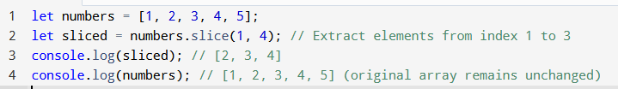
Adding and Removing Elements
slice(): is used to extract a portion of an array into a new array without modifying the original array.
Syntax: array.slice(startIndex, endIndex);
Example 1: Extracting a portion of the array
Notes:
startIndex: Starting index (inclusive).
endIndex: Ending index (exclusive).

Slide 80

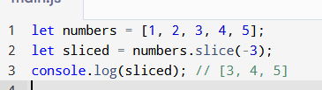
Adding and Removing Elements
Example 2: Copying an entire array
Example 3: Using negative indices
Notes:
startIndex: Starting index (inclusive).
endIndex: Ending index (exclusive).

Slide 81
Key Differences Between splice() and slice()
Feature | splice() | slice()
Purpose | Add, remove, or replace elements | Extract a portion of the array
Modifies original? | Yes | No (returns a new array)
Return value | Deleted elements as an array | Extracted elements as a new array

Slide 82
Takeaway questions
Given the array, let fruits = ['apple', 'banana', 'cherry', 'date', 'elderberry'];
Write a code snippet to create a new array containing only 'banana' and 'cherry'.
Extract the last two elements of the array into a new array.
Usinng the first array,
Remove 'cherry' from the array.
Replace 'date' with ‘pineapple‘
Notes:
Slice
Splice()

Slide 83

3

Slide 84
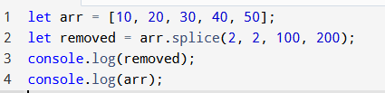
4

Slide 85
Searching in Arrays
indexOf(): returns the first index at which a specified element is found in an array.
If the element is not found, it returns -1.
Syntax: array.indexOf(searchElement, fromIndex)
let numbers = [1, 2, 3, 2, 5];
console.log(numbers.indexOf(2)); // 1 (first occurrence of 2)
console.log(numbers.indexOf(4)); // -1 (4 is not in the array)
console.log(numbers.indexOf(2, 2)); // 3 (search starts from index 2)
Uses strict equality (===)
Notes:
fromIndex (optional): The index to start the search from. Default is 0.

Slide 86
Searching in Arrays
lastIndexOf(): returns the last index at which a specified element is found in an array.
Syntax: array.lastIndexOf(searchElement, fromIndex)
starts at a specified index and searches from right to left (from the given position to the beginning of the array).
If the element is not found, it returns -1
let numbers = [1, 2, 3, 2, 5];
console.log(numbers.lastIndexOf(2)); // 3 (last occurrence of 2)
console.log(numbers.lastIndexOf(4)); // -1 (4 is not in the array)
console.log(numbers.lastIndexOf(2, 2)); // 1 (searches backward up from index 2)
Notes:
fromIndex: Default is the last element (array.length-1).

Slide 87
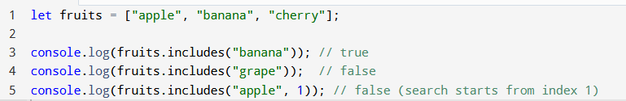
Searching in Arrays
includes(): checks if an array contains a specified value and returns a boolean (true or false).
Syntax: array.includes(searchElement, fromIndex);
Uses strict equality (===)
Notes:
fromIndex (optional): The index to start the search from. Default is 0

Slide 88
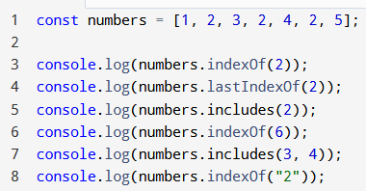
Takeaway question
What’s the output?
Write a function countOccurrences(arr, value) that returns the number of occurrences of value in the array.
use indexOf() in a loop to find all the occurrences.
Notes:
Update the index by calling indexOf again, starting from the next position (index + 1)

Slide 89
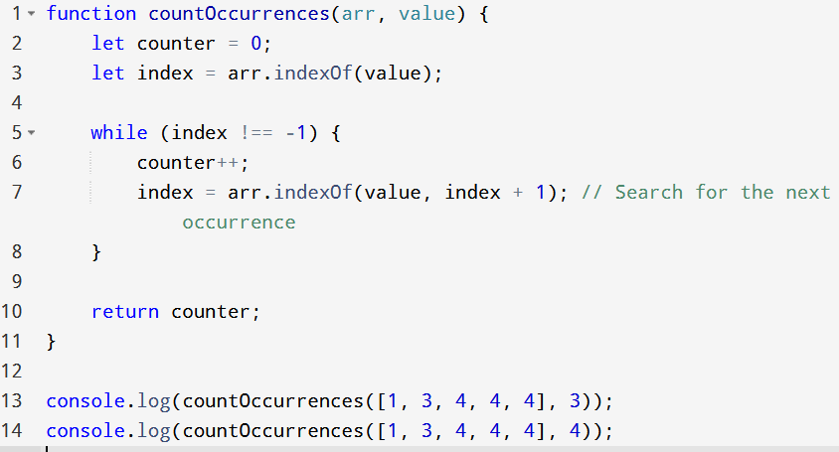
2

Slide 90
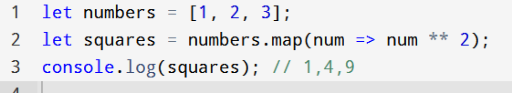
Array Transformation
map(): creates a new array by applying a function to each element of the original array.
It does not modify the original array.
Example for map():
the map() method begins by creating a new empty array, where the results of applying the function will be stored The first element in the numbers array is 1. The function is called with num = 1. Inside the function, num ** 2 is computed, which equals 2 This result (2) is pushed into the new array, And so on … After all the elements have been processed, the new array, now contains the values. The map() function returns this new array as the result
Notes:
Can also be written this way, let numbers = [1, 2, 3, 4, 5];
let doubledNumbers = numbers.map(function(num) { return num ** 2;});

Slide 91
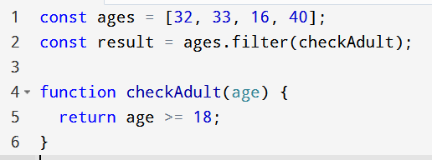
Array Transformation
filter(): creates a new array containing all elements that pass a specified test (return true).
It does not modify the original array.
Example,

Slide 92
Takeaway questions
Write a function that filters out all strings with a length less than 5 from an array.
const words = ["apple", "bat", "banana", "dog", "elephant"];
Write a function that filters out objects where the age property is less than 18.
const people = [ { name: "Alice", age: 17 }, { name: "Bob", age: 22 }, { name: "Charlie", age: 15 }, { name: "Dave", age: 30 } ];
Notes:
return arr.filter(word => word.length >= 5);

Slide 93
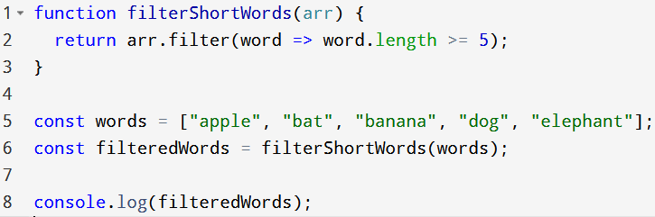
1

Slide 94
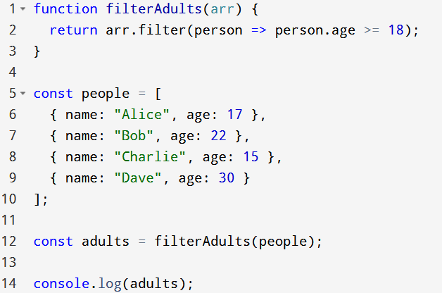
2

Slide 95
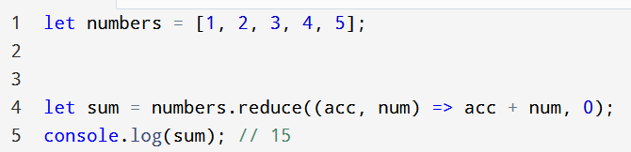
Array Transformation
reduce(): executes a reducer function on each element of the array, resulting in a single output value.
It can be used to sum, multiply, or accumulate values.
Notes:
After all elements in the array have been processed, the reduce() function returns the final value of the accumulator,
Reduces array to a single value (of any type)

Slide 96
Takeaway questions
Write a reduce() function to find the average of this array of numbers
const numbers = [1, 2, 3, 4, 5, 6, 7, 8];
Use reduce() to multiply all numbers in the array
const numbers = [15, 6, 25, 8, 2];
Use reduce() to count how many even numbers are in this array (homework)
const numbers = [1, 2, 3, 4, 5, 6, 7, 8];
Notes:
const average = numbers.reduce((sum, num) => sum + num, 0) / numbers.length;

Slide 97
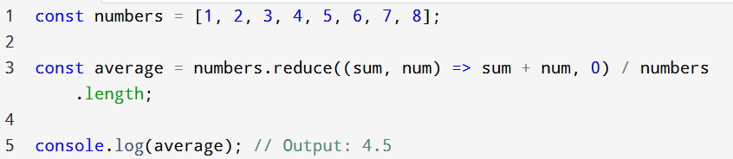
1

Slide 98
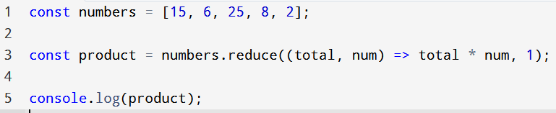
2

Slide 99
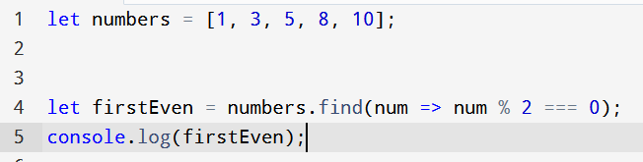
Find()
Find(): is used to return the first element in an array that satisfies a specified condition (callback function).
If no elements satisfy the condition, it returns undefined.
Example,
Notes:
Stops searching once a match is found.

Slide 100
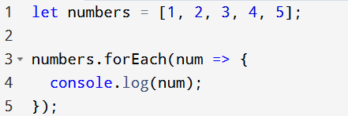
forEach()
forEach(): is used to execute a provided function once for each element in an array.
Unlike map() or filter(), it does not return a new array; it simply performs the specified action for each element.
Example,

Slide 101
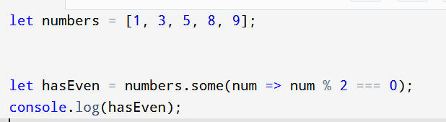
Some()
some(): is used to test whether at least one element in an array satisfies a provided condition .
It stops checking as soon as it finds a match and returns a boolean value
Example,

Slide 102
End of Part 1

